Slide 1
Department of Computer Science and Engineering (CYBER SECURITY)
Major Project
Automated Android Malware Detection Using Optimal Ensemble Learning Approach

Slide 2

OVERVIEW
Abstract
Introduction
Existing & Proposed System
Literature Survey
Design
Methodology
Implementation
Conclusion & References

Slide 3

ABSTRACT
Current technological advancement in computer systems has transformed the lives of humans from real to virtual environments. Malware is unnecessary software that is often utilized to launch cyberattacks. Malware variants are still evolving by using advanced packing and obfuscation methods. These approaches make malware classification and detection more challenging. New techniques that are different from conventional systems should be utilized for effectively combating new malware variants. Machine learning (ML) methods are ineffective in identifying all complex and new malware variants. The deep learning (DL) method can be a promising solution to detect all malware variants. This paper presents an Automated Android Malware Detection using Optimal Ensemble Learning Approach for Cybersecurity (AAMD-OELAC) technique. The major aim of the AAMD-OELAC technique lies in the automated classification and identification of Android malware. To achieve this, the AAMD-OELAC technique performs data preprocessing at the preliminary stage. For the Android malware detection process, the AAMD-OELAC technique follows an ensemble learning process using threeMLmodels, namely Least Square SupportVector Machine (LS-SVM), kernel extreme learning machine (KELM), and Regularized random vector functional link neural network (RRVFLN). Finally, the hunter-prey optimization (HPO) approach is exploited for the optimal parameter tuning of the three DL models, and it helps accomplish improved malware detection results. To denote the supremacy of the AAMD-OELAC method, a comprehensive experimental analysis is conducted. The simulation results portrayed the supremacy of the AAMD-OELAC technique over other existing approaches.

Slide 4
INTRODUCTION
Background
Cybersecurity threats from Android malware are increasing due to Android's dominance and evolving evasion techniques.
Traditional detection methods (Static & Dynamic Analysis) face limitations like code obfuscation and runtime complexity.
Objective: Introduce AAMD-OELAC: an intelligent malware detection approach combining data preprocessing, ensemble machine learning, and hyperparameter optimization.
Core Components
Ensemble Learning: Combines LS-SVM, KELM, and RRVFLN classifiers.
Hunter-Prey Optimization (HPO): Fine-tunes model parameters for optimal performance.
Key Contributions
Novel ensemble approach for Android malware detection.
Enhanced accuracy via optimized multi-model strategy.
Efficient detection of malicious patterns in APK files.

Slide 5
EXISTING & PROPOSED SYSTEMS:
Existing Systems
Techniques: DL with PE images, CNN with API call graphs, LSTM, multi-view DL, DAE-CNN, EfficientNet-B4, PIndroid, GA-optimized models.
Challenges: • Struggle with complex, high-dimensional data • Require large, accurately labeled datasets • Inconsistent detection of new/obfuscated malware
Proposed System – AAMD-OELAC Steps: • Data preprocessing • Ensemble of LS-SVM, KELM, and RRVFLN classifiers • Hunter-Prey Optimization (HPO) for hyperparameter tuning
Benefits: Improved detection accuracy Efficient handling of complex malware patterns First-of-its-kind intelligent ensemble framework

Slide 6
LITERATURE SURVEY:
1. Adversarial Learning-Based Detection & Defense
Study: Adversarial superiority in Android malware detection
Contribution: Evaluated 36 ML models using reinforcement learning (TRPO & PPO) to perform evasion attacks with ~96% success rate.
Defense: Proposed MalVPatch, enhancing adversarial robustness and improving model accuracy post-attack.
2. Hybrid Static-Dynamic Analysis
Study: You are what the permissions told me!
Contribution: Combined static (permissions) and dynamic (heap analysis) features using an improved DAMBA classifier.
Result: Achieved 97.5% F1-score with strong resistance to obfuscation and permission misuse.
3. Metaheuristic + Deep Learning Approach
Study: Metaheuristics with deep learning for malware detection
Technique: Rock Hyrax Swarm Optimization (RHSO) for feature selection + ARAE deep model.
Performance: Reached 99.05% accuracy on Andro-AutoPsy dataset.
4. Static Analysis with New Feature Engineering
Study: Automatic Android malware detection using static analysis and DL
Method: Developed new static features and a functional API-based DL model.
Results: 99.5% F1-score (binary classification) and 97% (multi-class malware types).

Slide 7
Module Description
Modules
Service Provider
In this module, the Service Provider has to login by using valid user name and password. After login successful he can do some operations such as Train & Test Data Sets, View Trained and Tested Datasets Accuracy in Bar Chart, View Trained and Tested Datasets Accuracy Results, View Prediction Of Cyber Attack Status, View Cyber Attack Prediction Status Ratio, Download Predicted Data Sets, View Cyber Attack Prediction Status Ratio Results, View All Remote Users..
View and Authorize Users
In this module, the admin can view the list of users who all registered. In this, the admin can view the user’s details such as, user name, email, address and admin authorizes the users.
Remote User
In this module, there are n numbers of users are present. User should register before doing any operations. Once user registers, their details will be stored to the database. After registration successful, he has to login by using authorized user name and password. Once Login is successful user will do some operations like REGISTER AND LOGIN, PREDICT CYBER ATTACK STATUS, VIEW YOUR PROFILE.

Slide 8

Requirements:
SYSTEM REQUIREMENTS
➢ H/W System Configuration:-
➢ Processor - Pentium –IV
➢ RAM - 4 GB (min)
➢ Hard Disk - 20 GB
➢ Key Board - Standard Windows Keyboard
➢ Mouse - Two or Three Button Mouse
➢ Monitor - SVGA
SOFTWARE REQUIREMENTS:
Operating system : Windows 7 Ultimate.
Coding Language : Python.
Front-End : Python.
Back-End : Django-ORM
Designing : Html, css, javascript.
Data Base : MySQL (XAMP Server).

Slide 9
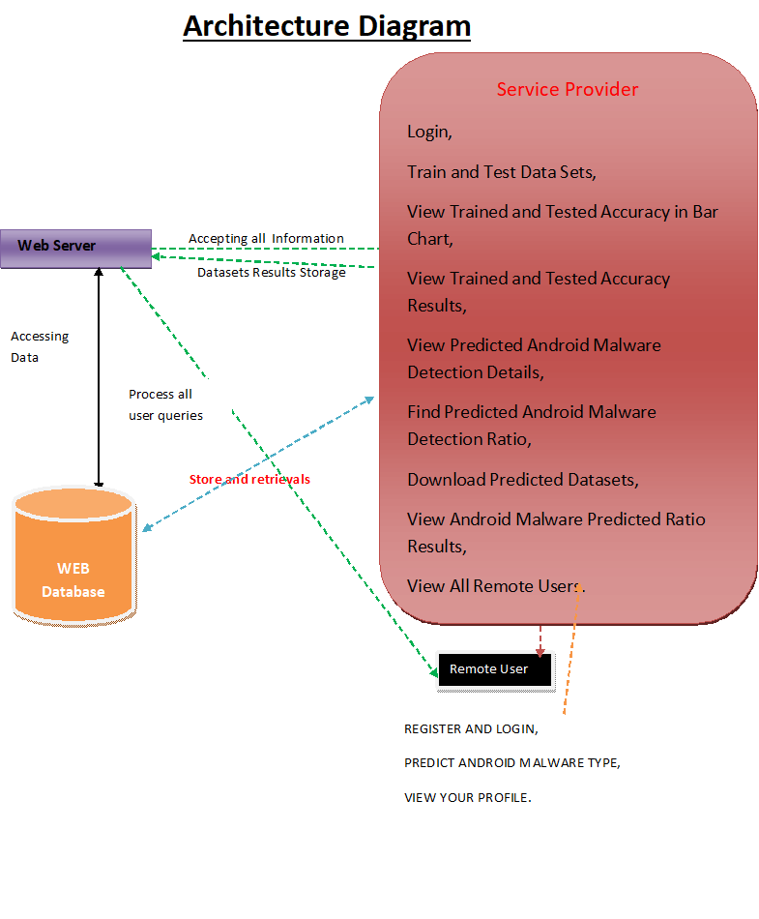
System Architecture:

Slide 10
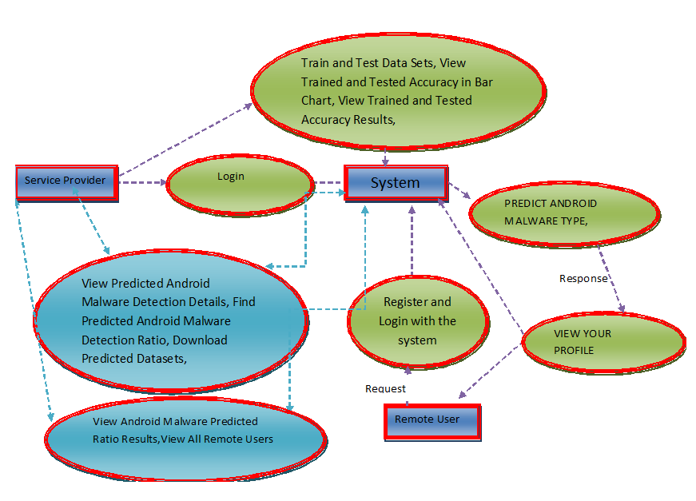
UML Diagrams:
Data flow diagram

Slide 11
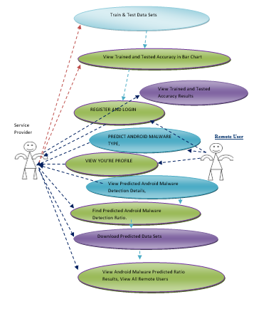
Use case diagram:

Slide 12
Implementation:
Algorithms for Android Malware Detection
1. Logistic Regression
Models relationship between binary or multi-class categorical outcome and input features.
Binary Logistic Regression: Used for Yes/No or 0/1 outcomes.
Multinomial Logistic Regression: For 3+ classes (e.g., Married, Single, Divorced).
Key Advantages:
No assumption of normality in predictors (unlike discriminant analysis).
Outputs include odds ratios, ROC curves, and confidence intervals.
Offers residual analysis, model selection, and validation tools
2. Naïve Bayes
Probabilistic classifier assuming feature independence.
Despite the naive assumption, it is:
Simple, fast, and scalable on large datasets.
Performs well compared to complex models.
Linear classifier like Logistic Regression and SVM, but uses probabilistic estimation.
Challenges:
Often underused in practice due to interpretability issues.
Improvements include better result presentation for easier understanding and deployment.

Slide 13
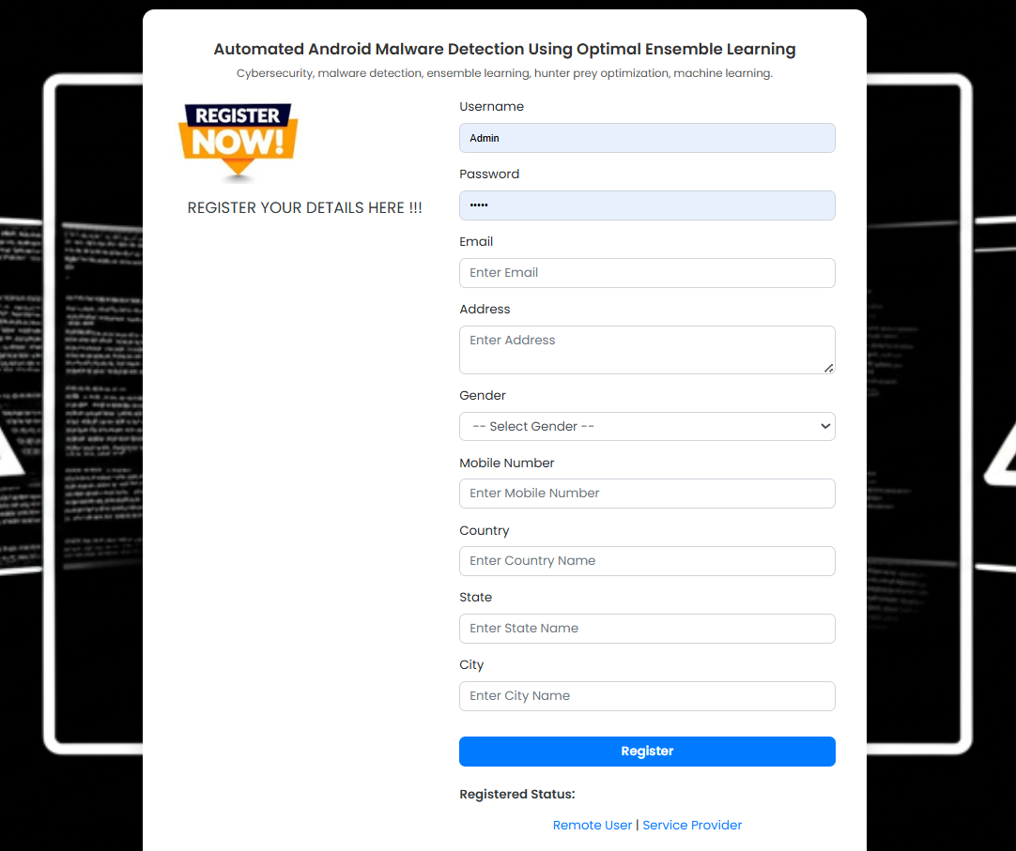
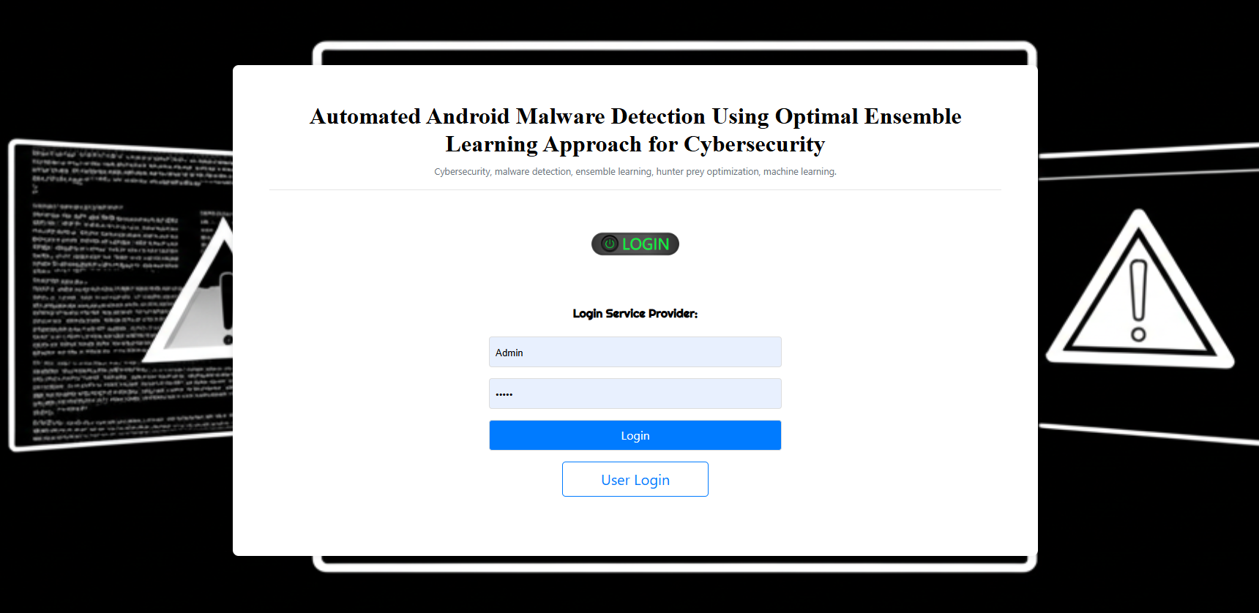
Design

Slide 14
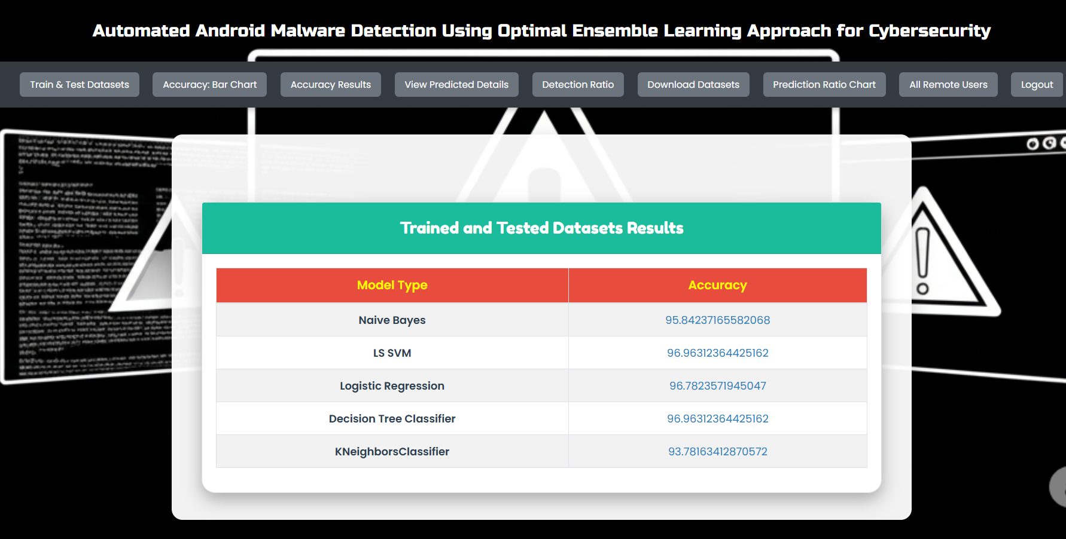
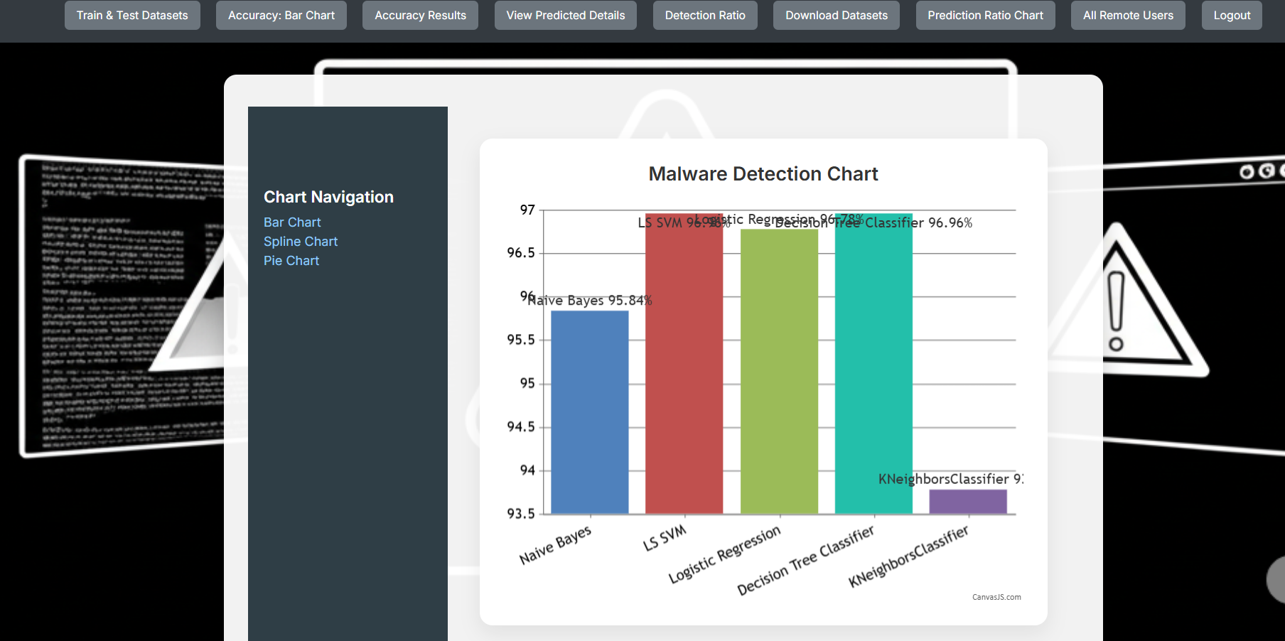

Slide 15
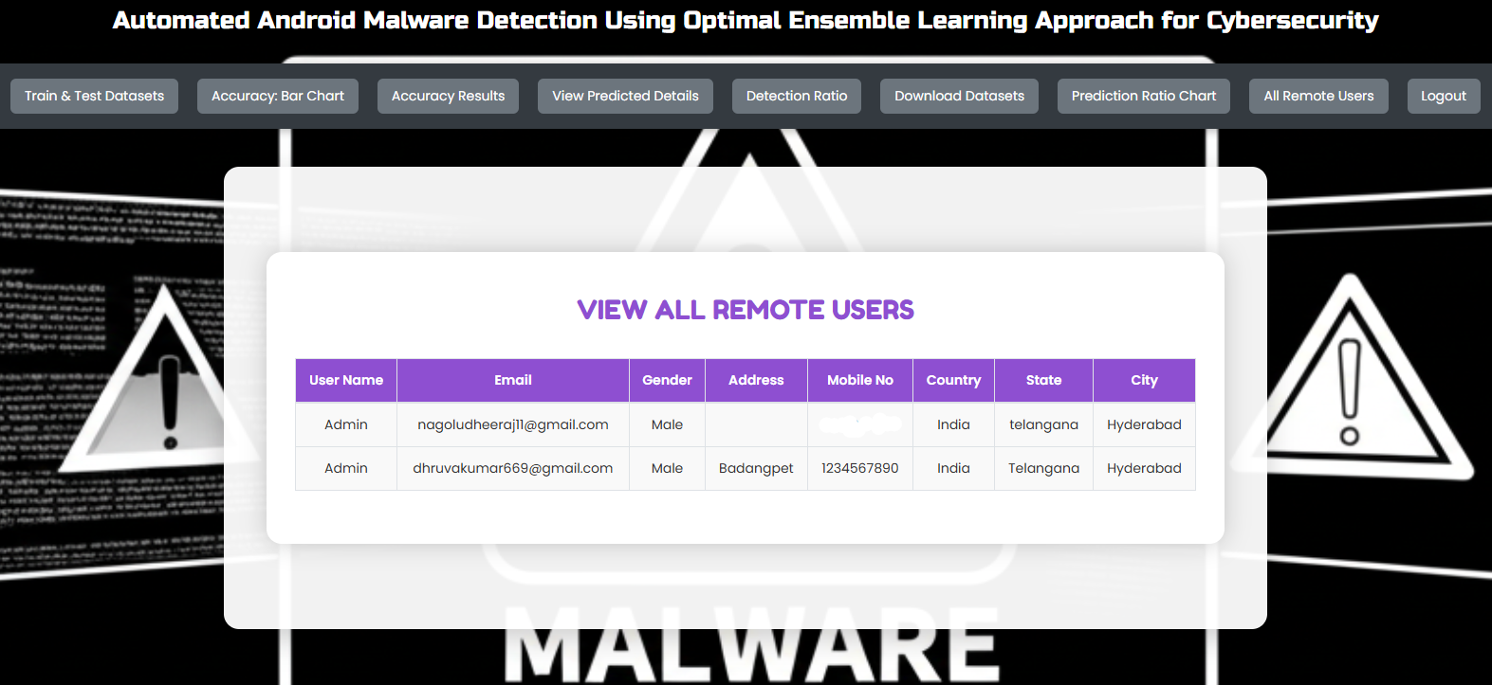
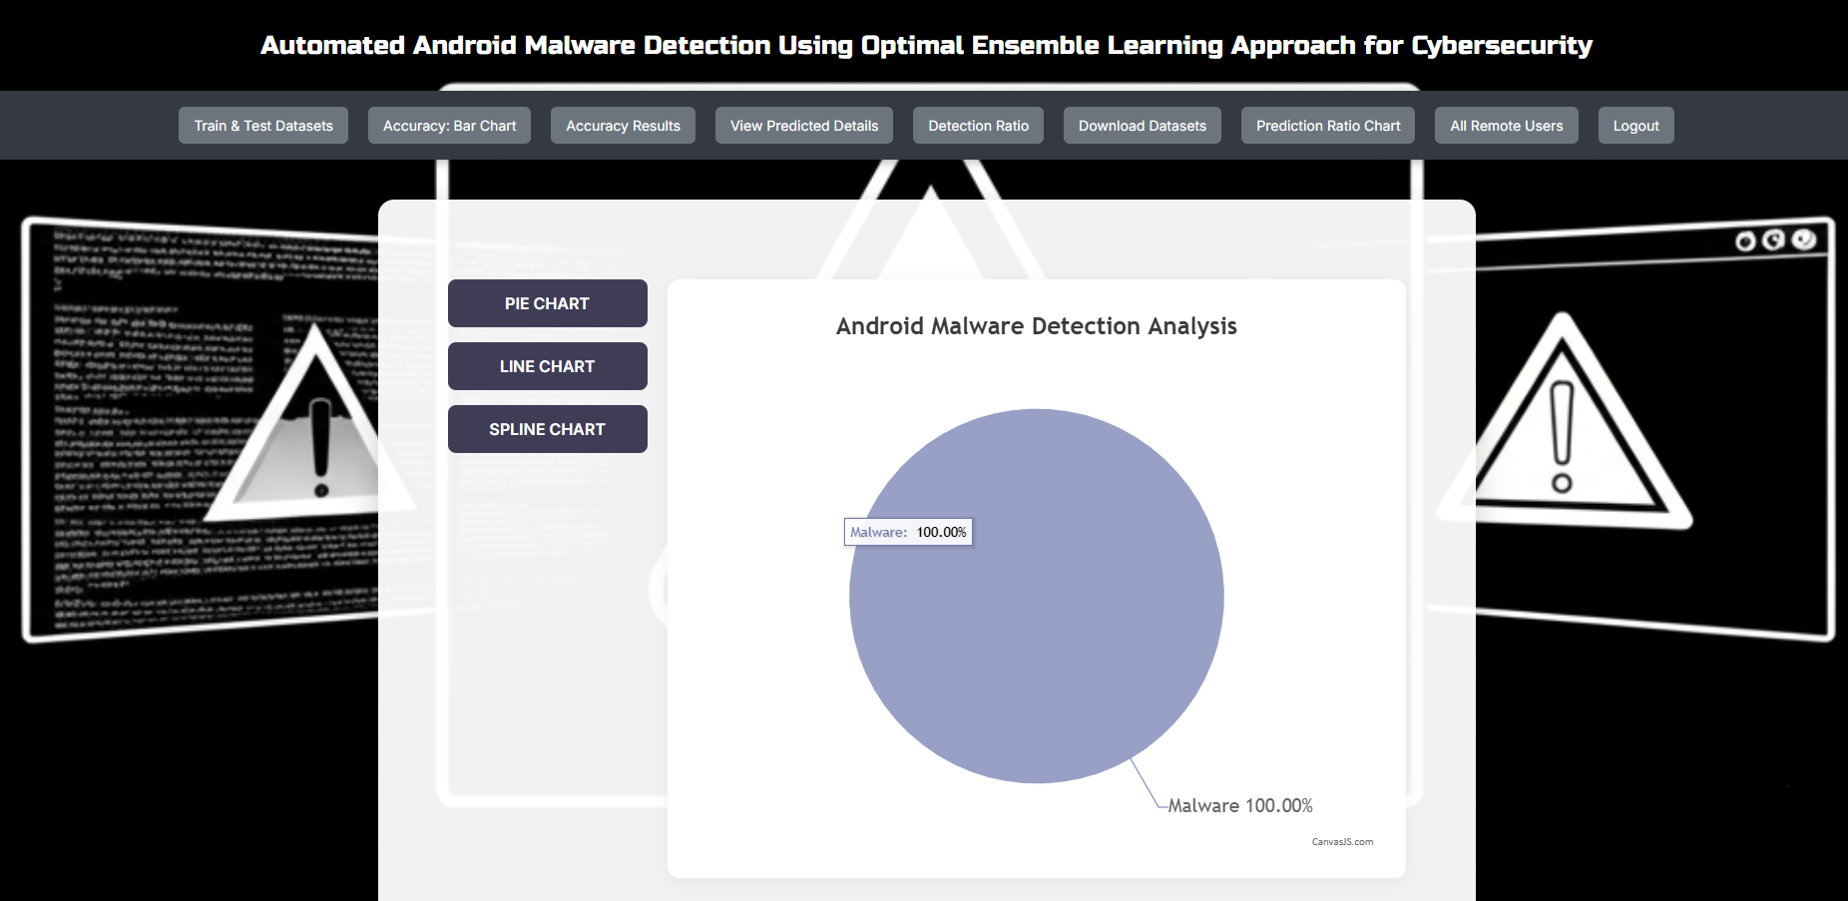

Slide 16
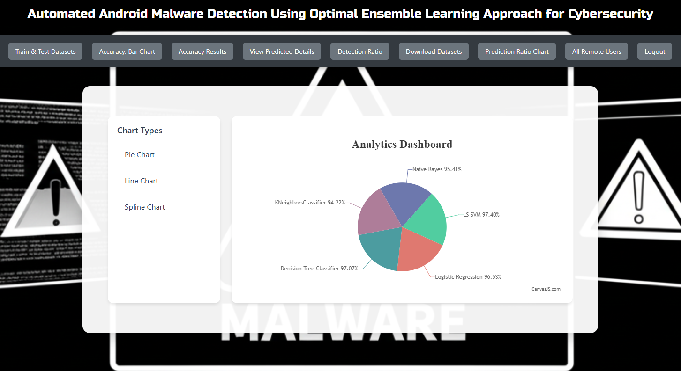
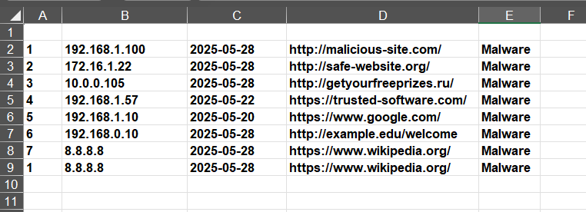

Slide 17
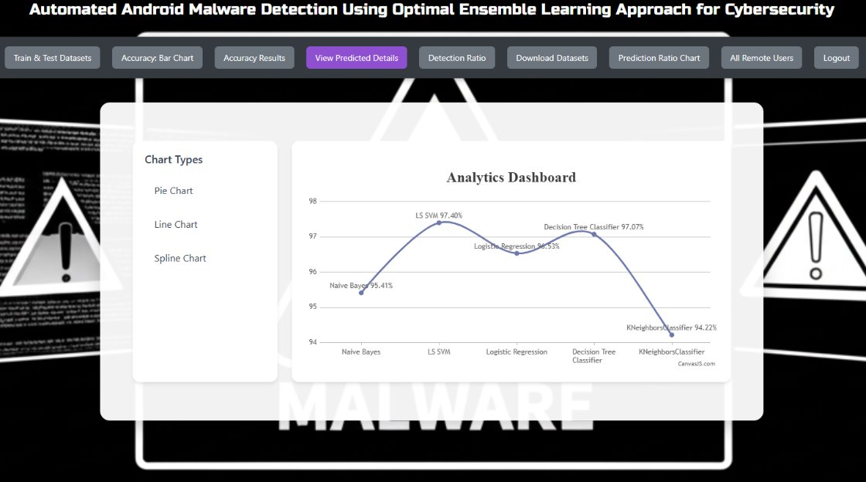

Slide 18

Conclusion
In this study, we have developed the design of the AAMD-OELAC technique for an accurate and automated Android malware detection process. The intention of the AAMD-OELAC approach focused on the automatic recognition and classification of Android malware. To achieve this, the AAMD-OELAC technique encompasses data preprocessing, ensemble classification, and HPO-based parameter tuning. For the Android malware detection process, the AAMD-OELAC technique follows an ensemble learning process using three ML models namely LS-SVM, KELM, and RRVFLN. Finally, the HPO algorithm is exploited for the optimal parameter tuning of the three DL models and it helps in accomplishing improved malware detection results. To portray the supremacy of the AAMD-OELAC method, a wide-ranging experimental analysis is conducted. The simulation results portrayed the supremacy of the AAMDOELAC technique over other existing approaches. Future work could focus on developing more advanced techniques to capture and analyze fine-grained behaviors, enabling better detection of sophisticated malware. In addition, future work could explore privacy-preserving approaches such as secure multi-party computation or federated learning, which enable collaborative malware detection without compromising user privacy.

Slide 19
References:
[1] H. Rathore, A. Nandanwar, S. K. Sahay, and M. Sewak, ‘‘Adversarial superiority in Android malware detection: Lessons from reinforcement learning based evasion attacks and defenses,’’ Forensic Sci. Int., Digit. Invest., vol. 44, Mar. 2023, Art. no. 301511.
[2] H. Wang, W. Zhang, and H. He, ‘‘You are what the permissions told me! Android malware detection based on hybrid tactics,’’ J. Inf. Secur. Appl., vol. 66, May 2022, Art. no. 103159.
[3] A. Albakri, F. Alhayan, N. Alturki, S. Ahamed, and S. Shamsudheen, ‘‘Metaheuristics with deep learning model for cybersecurity and Android malware detection and classification,’’ Appl. Sci., vol. 13, no. 4, p. 2172, Feb. 2023.
[4] M. Ibrahim, B. Issa, and M. B. Jasser, ‘‘A method for automatic Android malware detection based on static analysis and deep learning,’’ IEEE Access, vol. 10, pp. 117334–117352, 2022.
[5] L. Hammood, İ. A. Doğru, and K. Kılıç, ‘‘Machine learning-based adaptive genetic algorithm for Android malware detection in auto-driving vehicles,’’ Appl. Sci., vol. 13, no. 9, p. 5403, Apr. 2023.
[6] P. Bhat and K. Dutta, ‘‘A multi-tiered feature selection model for Android malware detection based on feature discrimination and information gain,’’ J. King Saud Univ.-Comput. Inf. Sci., vol. 34, no. 10, pp. 9464–9477, Nov. 2022.
[7] D.Wang, T. Chen, Z. Zhang, and N. Zhang, ‘‘A survey of Android malware detection based on deep learning,’’ in Proc. Int. Conf. Mach. Learn. Cyber Secur. Cham, Switzerland: Springer, 2023, pp. 228–242.
[8] Y. Zhao, L. Li, H. Wang, H. Cai, T. F. Bissyandé, J. Klein, and J. Grundy, ‘‘On the impact of sample duplication in machine-learning-based Android malware detection,’’ ACM Trans. Softw. Eng. Methodol., vol. 30, no. 3, pp. 1–38, Jul. 2021.
[9] E. C. Bayazit, O. K. Sahingoz, and B. Dogan, ‘‘Deep learning based malware detection for Android systems: A comparative analysis,’’ Tehnički vjesnik, vol. 30, no. 3, pp. 787–796, 2023.
[10] H.-J. Zhu, W. Gu, L.-M. Wang, Z.-C. Xu, and V. S. Sheng, ‘‘Android malware detection based on multi-head squeeze-and-excitation residual network,’’ Expert Syst. Appl., vol. 212, Feb. 2023, Art. no. 118705.

Slide 20
THANK YOU

